Slide 1
Topic 07 Filesystem Basics

Slide 2
Contents
File Navigation
Important Directories
Managing Files & Directories commands
File Names and File Globbing
Examining Files
Editing Files with vi
Locating Files with locate and find
Compressing Files: gzip and bzip2
Archiving Files with tar

Slide 3
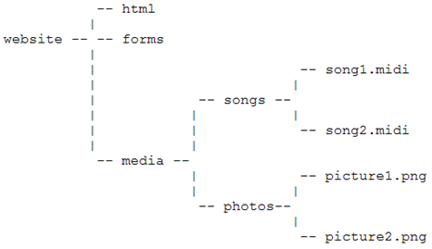
Filesystem Navigation
Special Directory Names
. Current Working Directory
.. Parent Directory
~ User’s Home Directory
- Previous Working Directory

Slide 4
Directories
The directory “.” refer to the directory itself.
The directory “..” refer to the parent directory.
Directories have at least a link count of 2. Once by itself, once by its parent directory, and one link for every child directory. Link count = folders
/home
The /home/student directory has 4 links
/home/student
/home/student/reports
/home/student/images

Slide 5
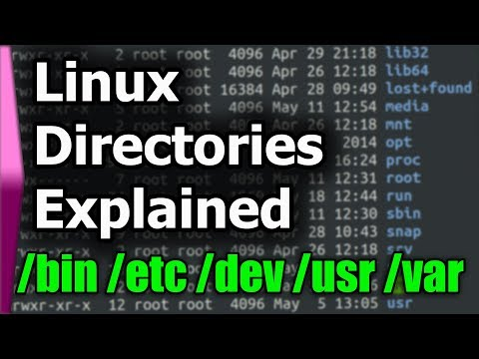
Important Directories
/tmp Temp files (required by X windows for non root login)
/etc Configuration files
/bin and /usr/bin Binary files (programs)
/sbin and /usr/sbin Binary files for superuser root
/var Files whose contents changes, eg log files
/boot Holds the kernel image and boot loader files
/home Users' home directories
/root root's home directory
/media removable media
/mnt temp mount points (network / HDD)
Notes:
If tmp is full, a non root user can login for 10 sec and will be back to login screen.

Slide 6
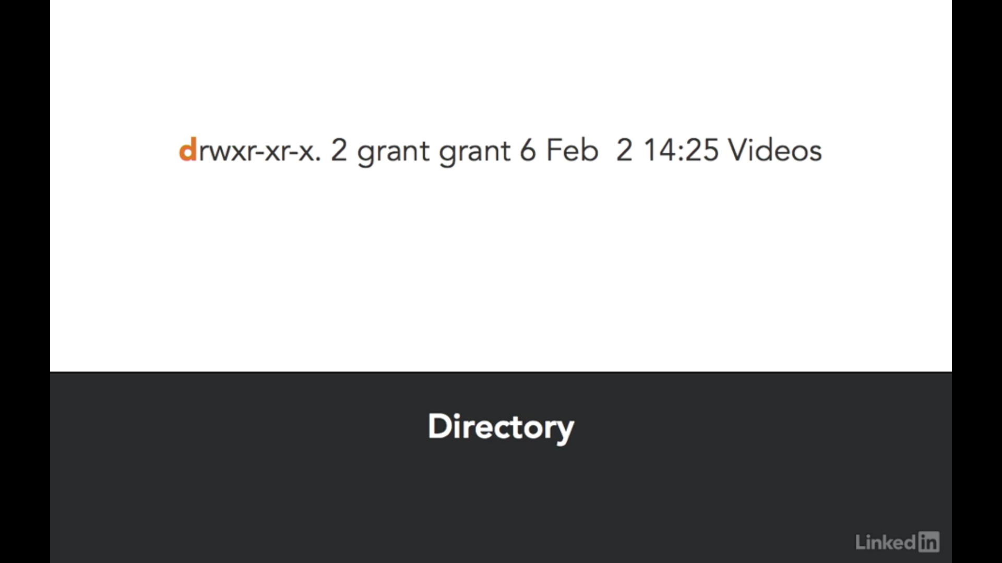
First character
Notes:
In most operating systems a file is an object, such as a document or photo that's saved on the hard disk. These files are organized using named folders in a hierarchy. The first type of file that we'll talk aboutis a directory. A directory is a list of other files. It helps us organize our system so it's easier to find our files. We can identify directories by looking at the first character on the left of a long list using ls space, dash L. That first character should be the letter D. If the first character is a hyphen, then it's a regular file.
This includes most traditional files, like documents and photos. If the first character's an L, then it's a symbolic link. You can think of a symbolic link as a shortcut to another file. Viewing these files with ls space, dash L will show you where the link is pointing to. If the first character is a C, it's a character device file and these files output or input characters. For instance, the slash dev slash random device file outputs random characters. If the first character's a B, then it's a block device file.
This file represents block devices, such as hard drives or USB sound drives.A socket file has an S as the first character. A socket file facilitates the communication of one application to another. If the first character's a P, then the file is a named pipe. A named pipe is also called a FIFO or first in, first out. These are buffers for plays in data anna Q to be processed by other applications. Linux takes the idea of everything being a file so far that even the output of application data on the screen is considered a file that hasn't yet been saved.
The slash proc directory has files with data in them that can be read but have a file size of zero bytes. These are attributes and information about the Linux OS presented in a form of regular files and directories. They don't physically exist but appear just like normal files and are created on the fly by the kernel when they're read. This idea of everything being a file allows us to view important system information using nothing but simple file viewers. It's a very powerful concept.

Slide 7

The following video tutorial shows you how to find out your dns server IP address assigned by an ISP router or dhcp server under Linux or Unix operating systems using both command line and graphical user interfaces:
Further, you can use the dig command and host command to verify that DNS working: $ host cyberciti.biz $ dig nixcraft.com
$ cat /etc/resolv.conf
OR use the less command/more command shell pagers:
$ less /etc/resolv.conf
Notes:
Command to find out your dns servers ip address under Linux/BSD/Unixish system
To see your DNS server address type the following cat command as shell prompt: $ cat /etc/resolv.conf OR use the less command/more command shell pagers: $ less /etc/resolv.conf Another option is to use the grep command/egrep command:
nameserver 203.54.1.20 nameserver 203.54.1.21 Where,
nameserver 203.54.1.20 : It is Name server IP address (in dot notation) of a name server that the resolver should query. All your application will use this IP address for DNS purpose.
Further, you can use the dig command and host command to verify that DNS working: $ host cyberciti.biz $ dig nixcraft.com

Slide 8

The Linux File system

Slide 9
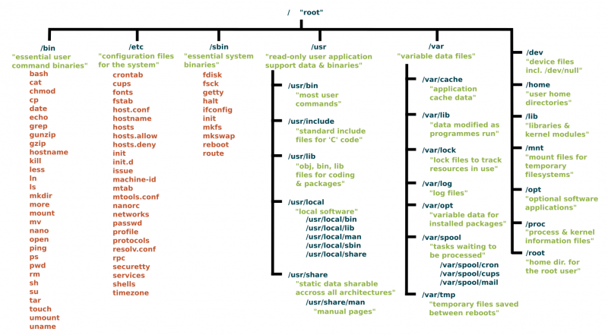
https://www.linux.com/blog/learn/intro-to-linux/2018/4/linux-filesystem-explained

Slide 10
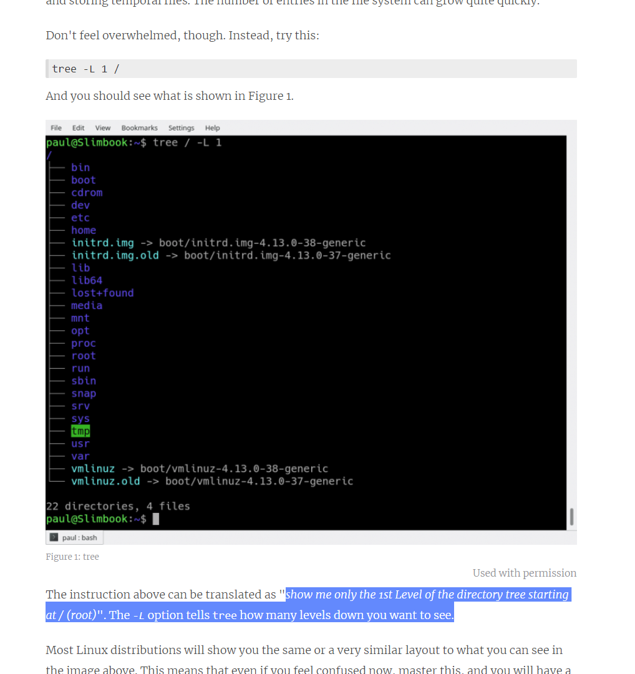
show me only the 1st Level of the directory tree starting at / (root)". The -L option tells tree how many levels down you want to see.
Notes:
Structure
It makes sense to explore the Linux filesystem from a terminal window, not because the author is a grumpy old man and resents new kids and their pretty graphical tools -- although there is some truth to that -- but because a terminal, despite being text-only, has better tools to show the map of Linux's directory tree.
In fact, that is the name of the first tool you'll install to help you on the way: tree. If you are using Ubuntu or Debian, you can do:
sudo apt install tree On Red Hat or Fedora, do:
sudo dnf install tree For SUSE/openSUSE use zypper:
sudo zypper install tree For Arch-like distros (Manjaro, Antergos, etc.) use:
sudo pacman -S tree ... and so on.
Once installed, stay in your terminal window and run tree like this:
tree / The / in the instruction above refers to the root directory. The root directory is the one from which all other directories branch off from. When you run tree and tell it to start with /, you will see the whole directory tree, all directories and all the subdirectories in the whole system, with all their files, fly by.
If you have been using your system for some time, this may take a while, because, even if you haven't generated many files yourself, a Linux system and its apps are always logging, cacheing, and storing temporal files. The number of entries in the file system can grow quite quickly.
https://www.linux.com/blog/learn/intro-to-linux/2018/4/linux-filesystem-explained

Slide 11
Managing Files Commands
The >> and > can be used to redirect output to a file (appending / overwriting it).
The cp command copies files. (-r command recursively copies )
The mv command moves or renames files.
The rm command removes files. (–r command recursively removes)
The mkdir command creates directories.
The rmdir command removes empty directories.
The ls -R displays entire directory trees.

Slide 12
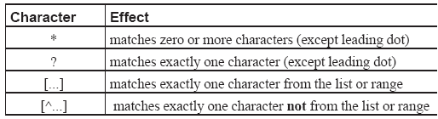
Filenames and File Globbing
File names can contain any character except “/”.
Files that start with a “.” are hidden files.
Wildcards can be used to match file names (file globbing).

Slide 13
Question
What is the command to list the files that start with system-config in /usr/share/doc?
Answer :
ls /usr/share/doc/system-config*
What is the command to list the files that start with the letter a, e, i, o or u in /usr/share/doc?
Answer :
ls /usr/share/doc/[aeiou]*

Slide 14
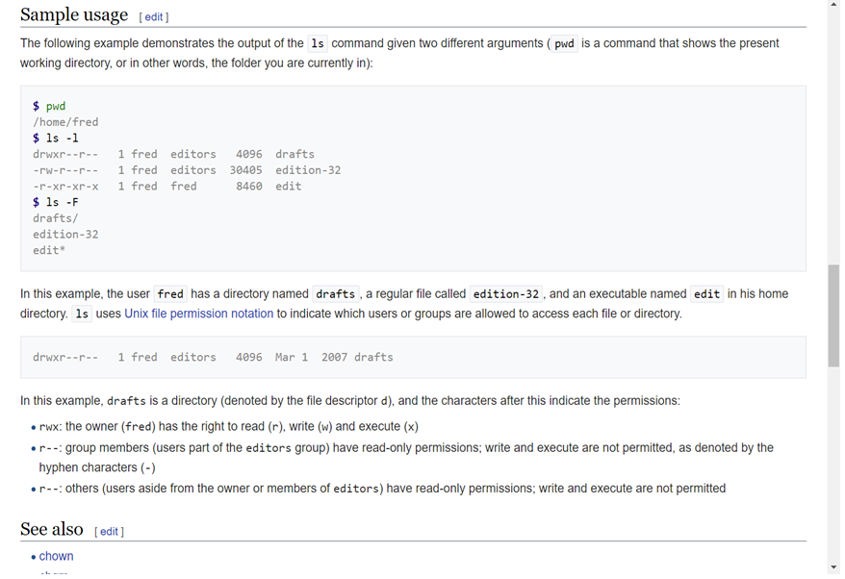
Notes:
https://en.wikipedia.org/wiki/Ls

Slide 15
Examining Files
The file command displays a file’s type.
Regular File - Storing data
Directory d Organising files
Symbolic Link l Shortcut to other files
Character Device Node c Accessing data
Block Device Node b Accessing data
Named Pipe p Interprocess communication
Socket s Interprocess communication

Slide 16
Examining Files (Device Nodes)
Device nodes exist in /dev, and act as a conduit (to read/write data) to/from a device driver.
Block devices read and write information in blocks at a time. Examples are hard drives and CD drives.
Character devices read and write information as a stream of bytes. Examples are keyboards and printers.
Terminals have device nodes, example, /dev/tty1 to /dev/tty6 for the 6 virtual consoles

Slide 17
Examining Files
The ldd command shown any linked dynamic library required by the program.
The less command is used to display the contents of a file, one page at a time.
The head and tail commands display the first or last few lines of a file.

Slide 18
Editing Files with vi
The vi editor is the most popular text Linux editor.
There are 3 commonly used modes in vi :
Command / normal mode : When vi starts, it is automatically in this mode. Keying "i“, “I”, “a”, “A”, “o” or “O” will put it in to Text Input mode.
Insert (Text Input) mode : In this mode, you can key in text. The word "INSERT" appears at the bottom of the screen. Pressing "Esc" will return to Command mode.
Command-line mode : From command mode use colon followed by a command. For example keying “:wq” to write and quit vi.

Slide 19
Editing Files with vi
Some useful commands in Command mode
i insert text before the cursor
I insert text at beginning of current line
a insert text after the cursor
A insert text at end of current line
o open a blank above current line to insert text
O open a blank line below current line to insert text
x delete the current character
dd delete the current line and put into buffer
D delete the rest of the line from the cursor
yy copy the current line to the buffer
p paste contents of buffer after cursor position
P paste contents of buffer before cursor position
u undo last operation

Slide 20
Editing Files with vi
Some useful commands in Command-line mode
:q quit vi
:q! quit vi without saving changes
:w save file and remain in vi
:wq save file and quit vi
:w file save file under new name file and remain in vi.
You will try vi in your practical session

Slide 21
Record and replay commands in vi
Sometimes you may need to repeat some commands in the vi editor
Can use the recording and replay function in the normal / command mode.
Start recording (in command mode)
q letter
Stop recording (in command mode)
q
Replay
@ letter
Any letter to identify the register where the recorded actions will be stored
letter -- User defined register key i.e. “a” or “z”

Slide 22
Locate
An indexed search from the database /var/lib/mlocate/mlocate.db
Database created / updated when updatedb command is executed.
Return results fast.

Slide 23
The find command syntax
Search for files on demand (no indexing needed)
Common options
-size nc File with size n bytes.
Eg. find /etc/sysconfig –type f -size 65c
-size +nc File with at least size n bytes.
Eg. find /etc/sysconfig –type f -size +5000c
-size +nk File with at least size n kilobytes.
Eg. find /etc/sysconfig –type f -size +10k
Notes:
https://www.lifewire.com/uses-of-linux-command-find-2201100
When you search by name across the whole drive, use the following syntax:
find / -name filename
The first part of the find command is obviously the word find.
The second part is where to start searching from.
The next part is an expression which determines what to find.
Finally the last part is the name of the thing to find.
Search Location Shortcuts
The first argument after find is the location you wish to search. Although you may specify a specific directory, most people use a metacharacter to serve as a substitute. The three metacharacters that work with this command include:
Period: specifies the current and all nested folders
Forward Slash: specifies the entire filesystem
Tilde: specifies the active user's home directory
Searching the entire filesystem is likely to generate a lot of access-denied errors. Run the command with elevated privileges (e.g., by using sudo), if you need to search in places your standard account normally cannot access.

Slide 24
Actions for the find command
-exec command ; Execute command on matching files. Use {} to indicate where filename should be substituted
-ok command ; Like -exec, but prompt for each file
-ls List file in ls -dils format

Slide 25
Compressing Files: gzip and bzip2
The gzip command is the most commonly used compression utility.
gzip files are uncompressed with the commands gunzip or gzip -d
gzip -r (recursive) will traverse the directory structure and compress all files.
The bzip2 command produces more compact compressed files but is more CPU intensive.
bzip2 files are uncompressed with the commands bunzip2 or bzip2 -d

Slide 26
Archiving Files with tar
The tar command can archive an entire directory structure into a single file. (called tarball)
Archive files usually have file extension of .tar (so that you know what to do)
Example
./music.tar

Slide 27
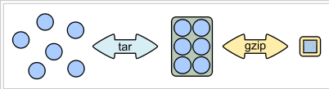
Archiving Files with tar
tar function can be summarized as:
Note : When extracting a compressed archive file, it is not necessary to have the -z or -j switch, as the tar command will recognise that the archive file is compressed, and decompress it accordingly.
Source : http://en.wikipedia.org/wiki/Tar_%28file_format%29

Slide 28
Archiving Files with tar
Common tar switches:
-c create a new archive file
-t list the contents of an archive file
-x extract files from an archive file
-f archive_file specify the archive filename
-v verbose mode
-z compress the archive file using gzip (resulting file usually have file extension of .tar.gz or .tgz.
-j compress the archive file using bzip (resulting file usually have file extension of tar.bz2 or .tb2 or .tbz2 or .tbz2

Slide 29
Demo
Downloading Wordpress
Before downloading the Wordpress archive, first create a directory which will hold our WordPress files:
sudo mkdir -p /var/www/example.com
The next step is to download the latest version of WordPress from the WordPress download page using the following wget command:
cd /tmp
wget https://wordpress.org/latest.tar.gz
Once the download is complete, extract the archive and move the extracted files into the domain’s document root directory:
tar xf latest.tar.gz
sudo mv /tmp/wordpress/* /var/www/example.com/
Note: you will try this in your assignment

Slide 30

tar

Slide 31
Summary
File Navigation
Important Directories
Managing Files and Directories
File Names and File Globbing
Examining Files
Editing Files
Locating Files with locate and find
Compressing Files: gzip and bzip2
Archiving Files with tar

